Slide 1


Hisham Alharbi
PhD Candidate
Kingdome of Saudi Arabia

Slide 2
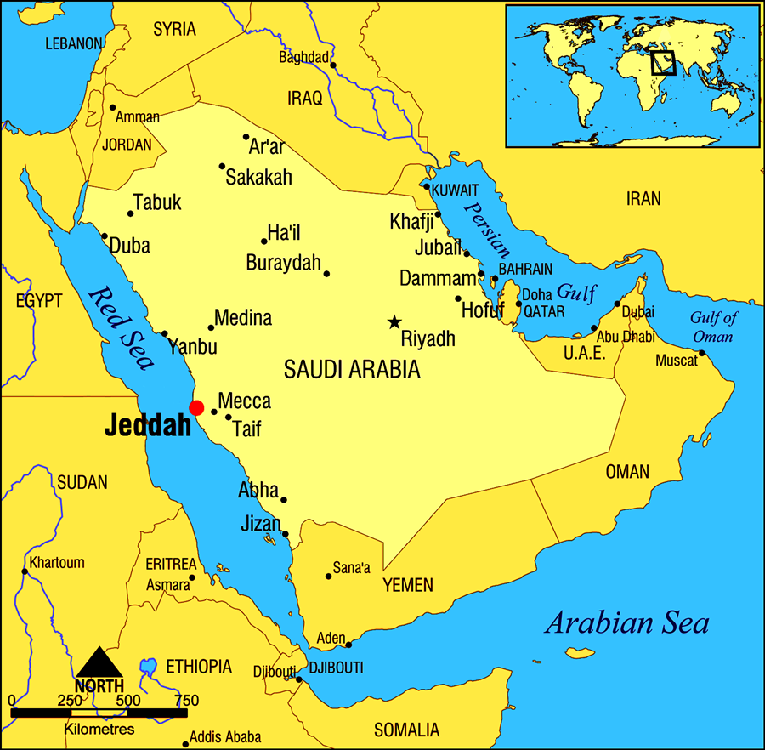

KSA in the World
1- Commercial city
2-Main Port with an international airport 3-population 4 million

Slide 3


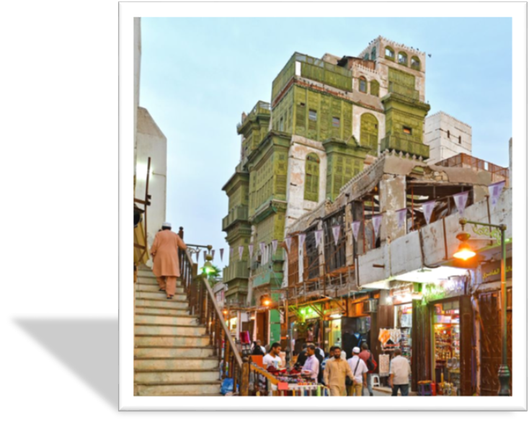
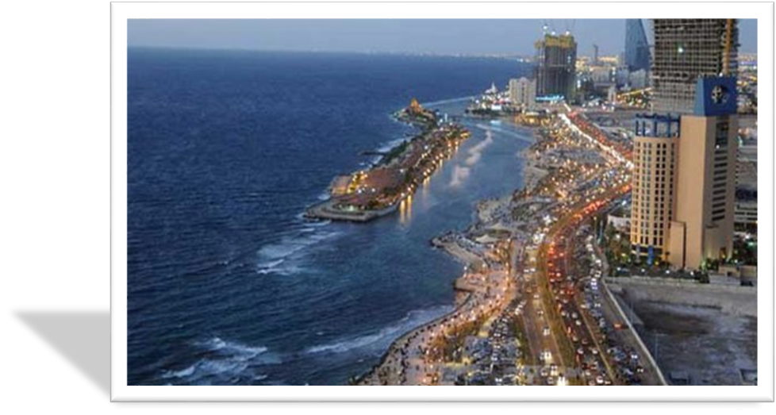
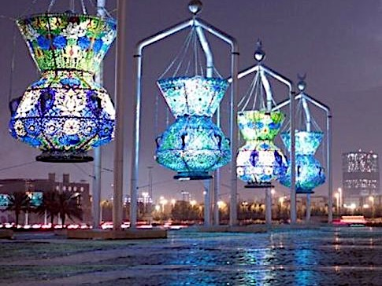
Post Cards from Jeddah

Slide 4
Jeddah Regional Laboratory
PRE- Marriage
TB
New Born
Virology
Blood Bank
Public Health
Clinical Biochemistry
Immunology

Slide 5
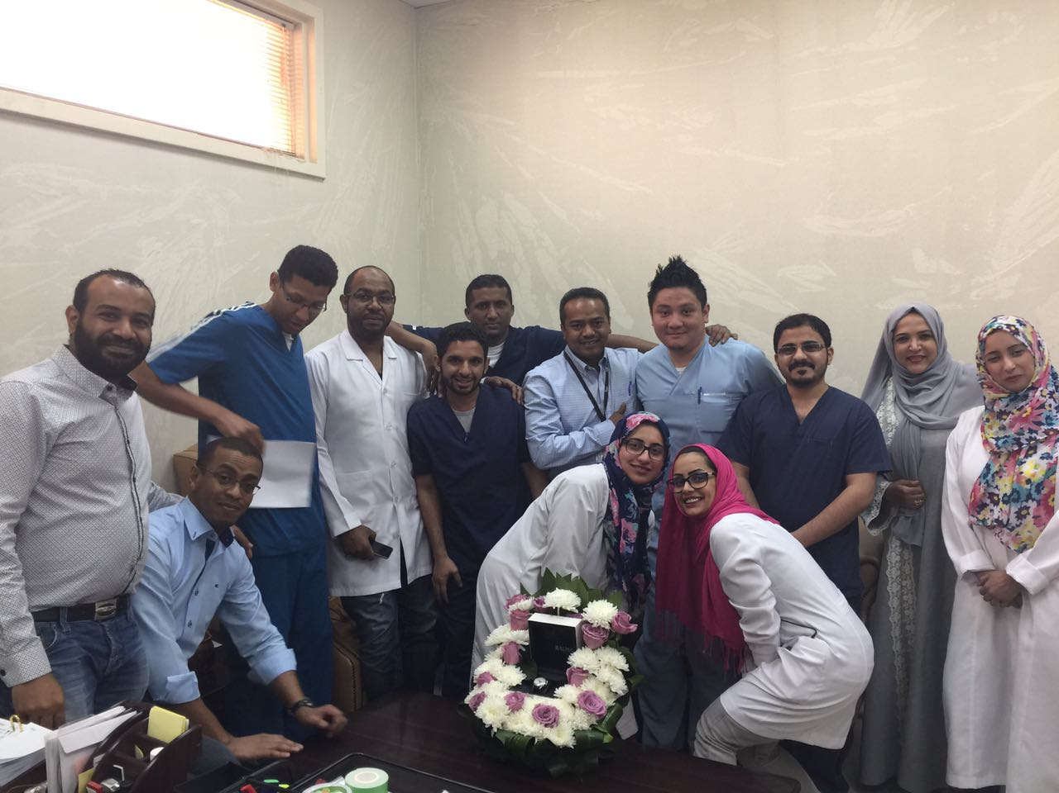
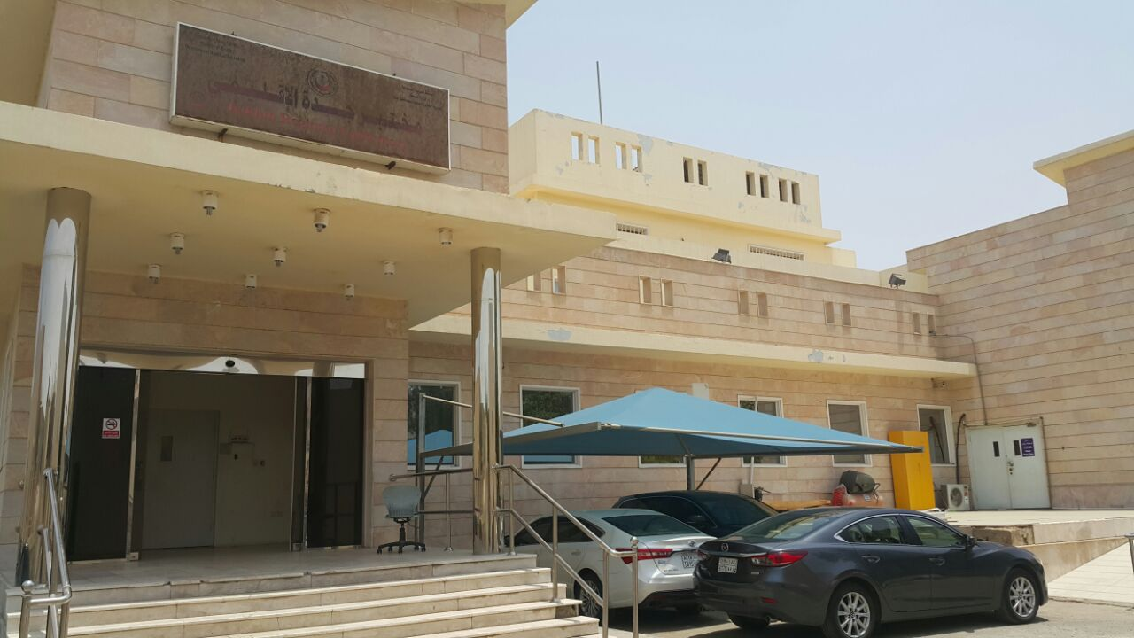
Jeddah Regional Laboratory Virology Department

Slide 6
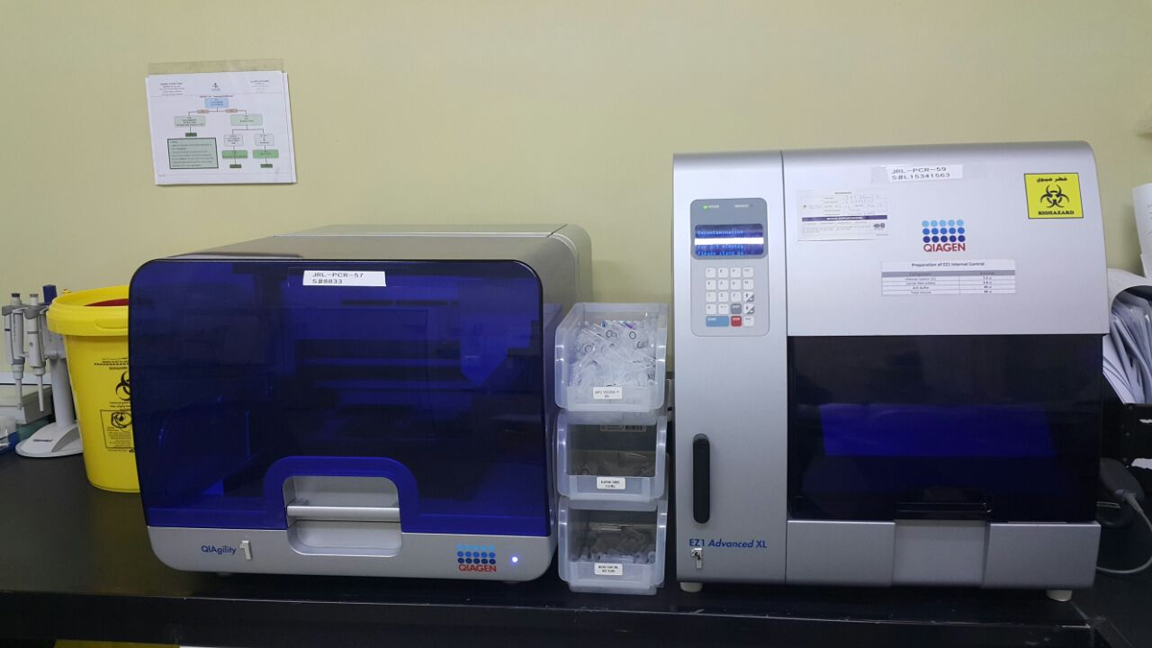
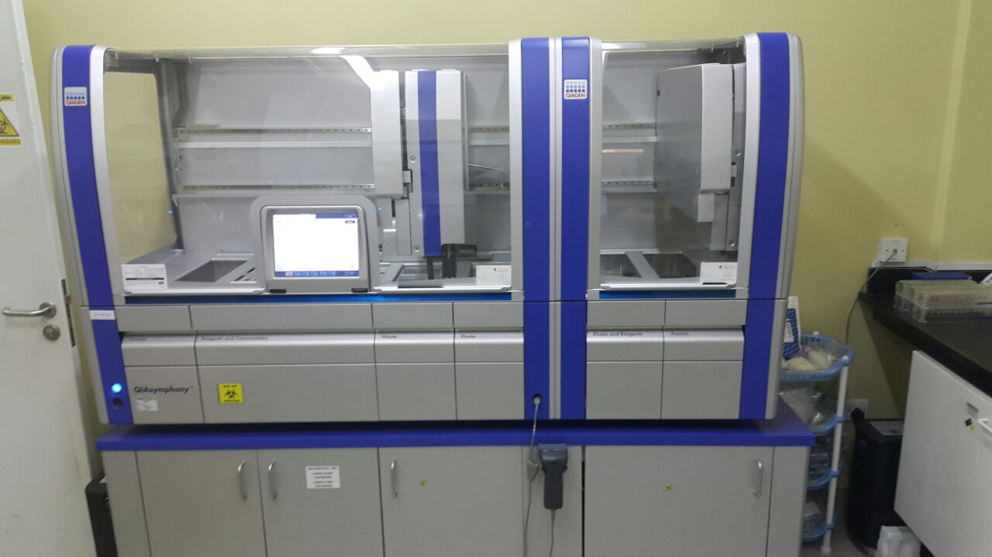
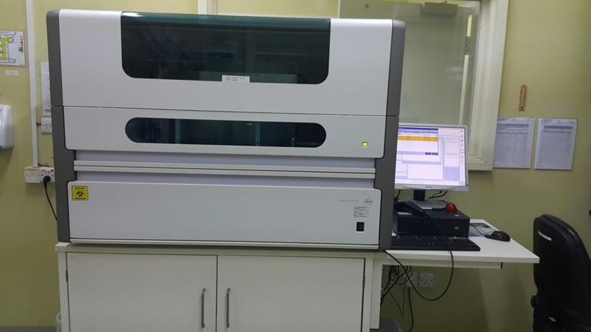
Extraction unite

Slide 7
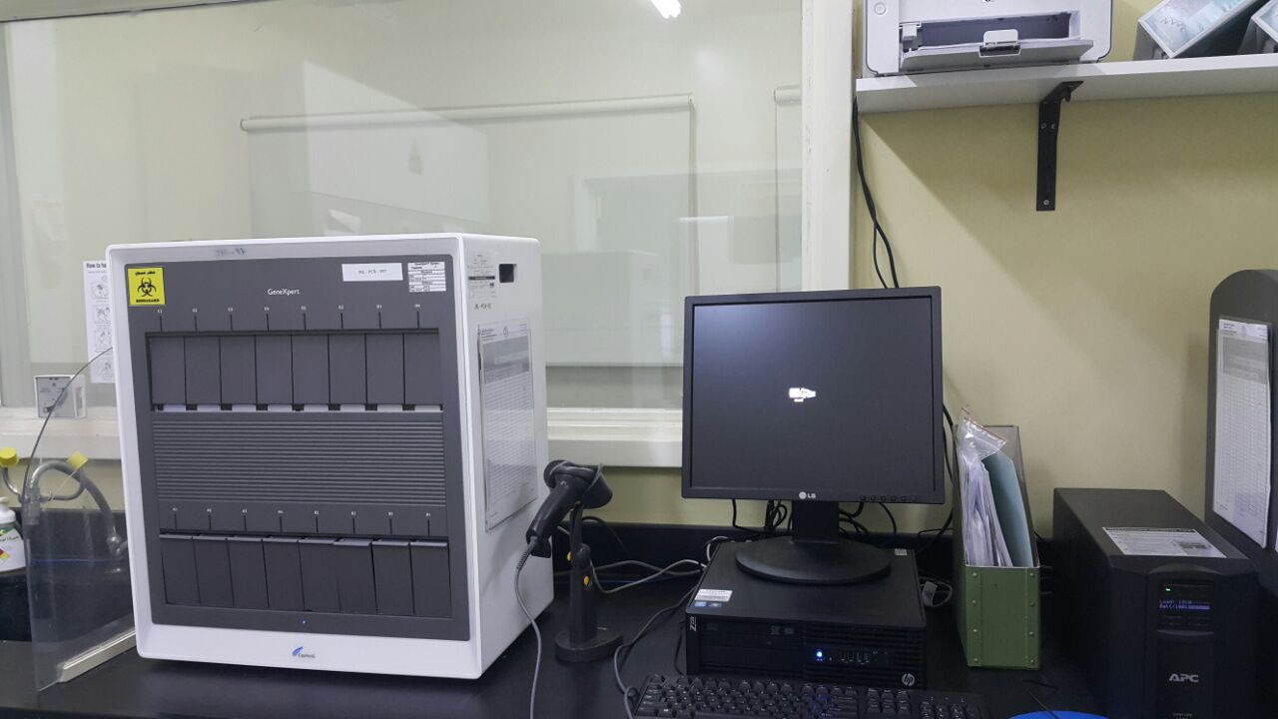
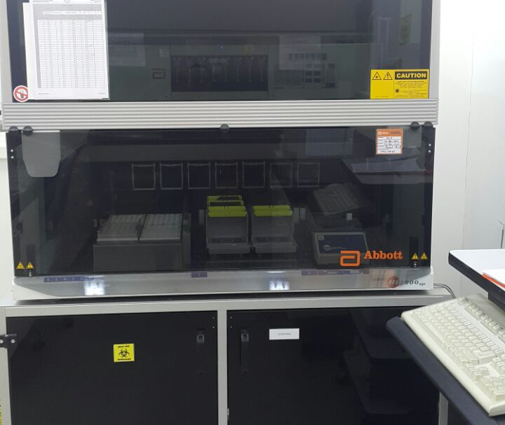
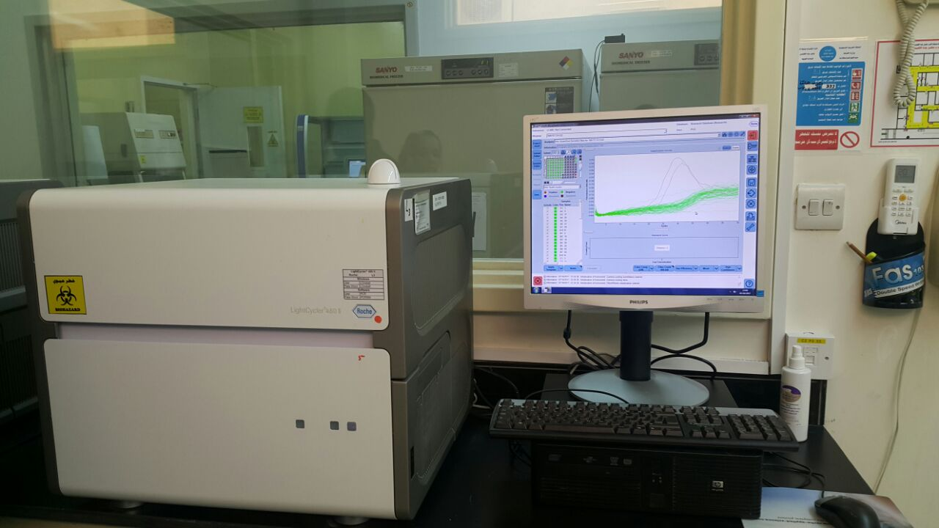
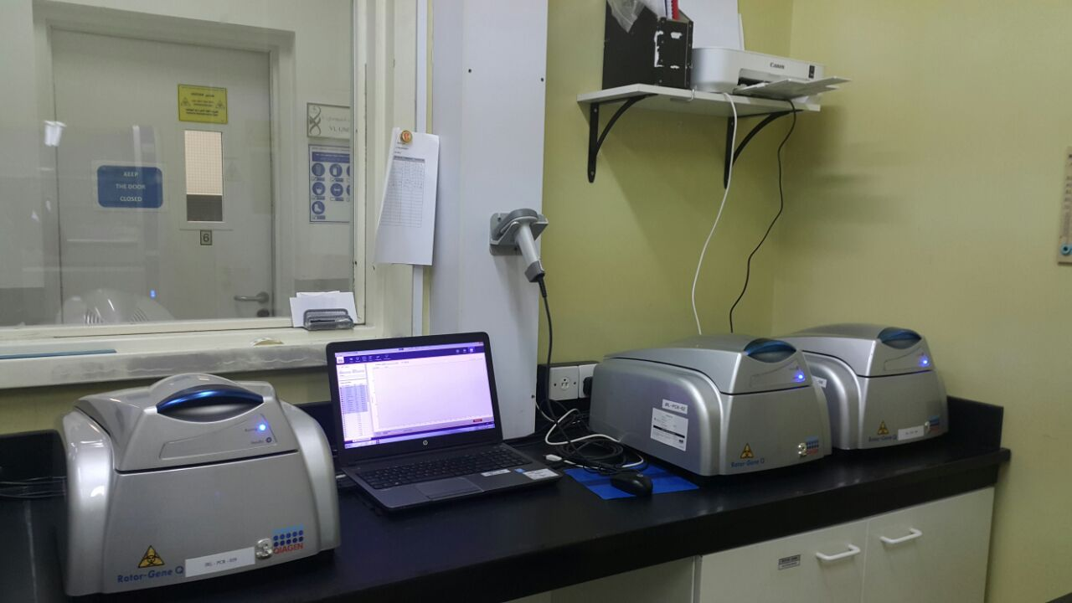
qPCR unite

Slide 8
Real Time PCR single and Multiplex
Viral Load
1- HIV
2-HCV
3-HBV
4-CMV
Haemorrhagic Fever Viruses
1- Dengue
2-Alkurma
3-Chikengunya
4-Rift Valley
5-Zika virus
6- West Nile
Respiratory viruses
1-MERS COV
2-Influnza A&B

Slide 9
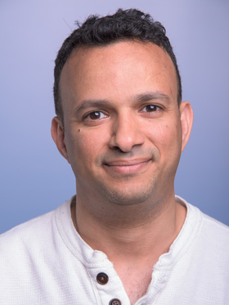
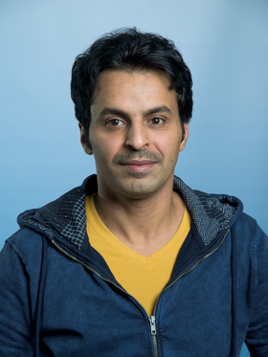
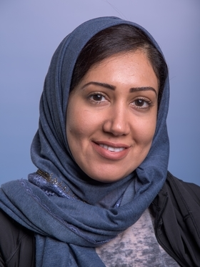
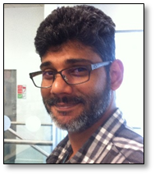
Vector Born Department
Hisham
Malaria Program
Hijri
Schistosoma
Program
Abdulwahab
Malaria Program
Ashwaq
Vector control

Slide 10
Main aim and Goal
The National Central Laboratory
1- An elite Institution in the middle east that lead research, build strategies, policies and methods in eliminating infectious diseases.
2- Contribute in the world of Science with new discovery, Knowledge, Training and mentoring for new researchers.

Slide 11


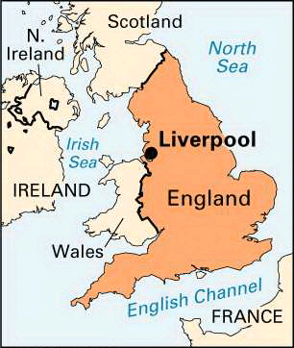
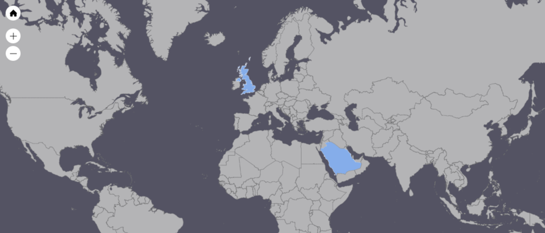


Moving to the United Kingdome

Slide 12


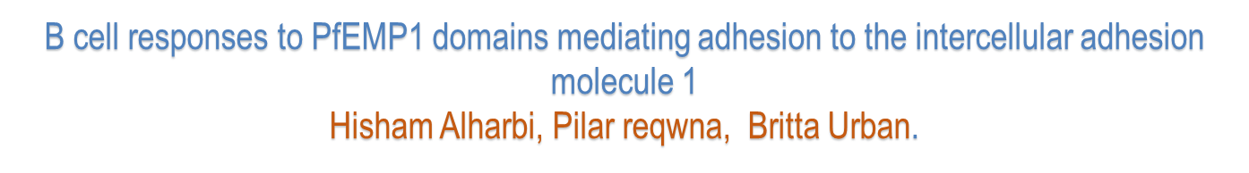

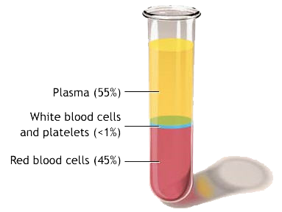

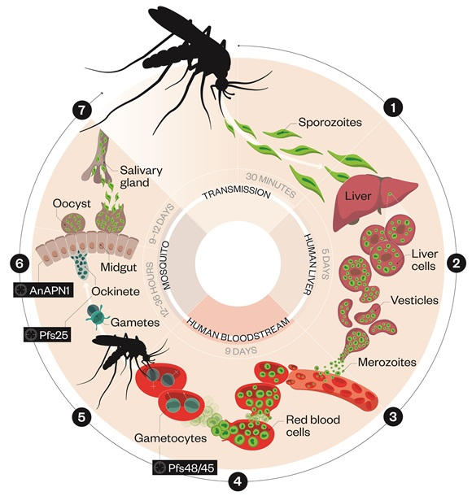

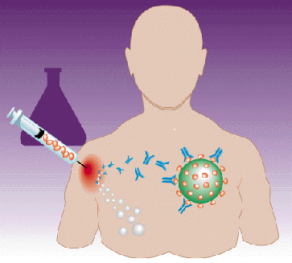

Blocking cell adhesion
Monoclonal antibodies production
Multiple infection
Immunity
Targeting the Erythrocyte stage
V(D)J gene sequencing

Slide 13
Monoclonal Antibodies Titration curves

Slide 14
Next Step
Characterization of binding of mAbs to different DBLβ by ELISA and FACS
Characterization of blocking of iRBCs adhesion to ICAM-1 by cross-reactive and selected variant-specific antibodies
Molecular analysis of Ig variable region of cross-reactive versus variant-specific antibodies

Slide 15
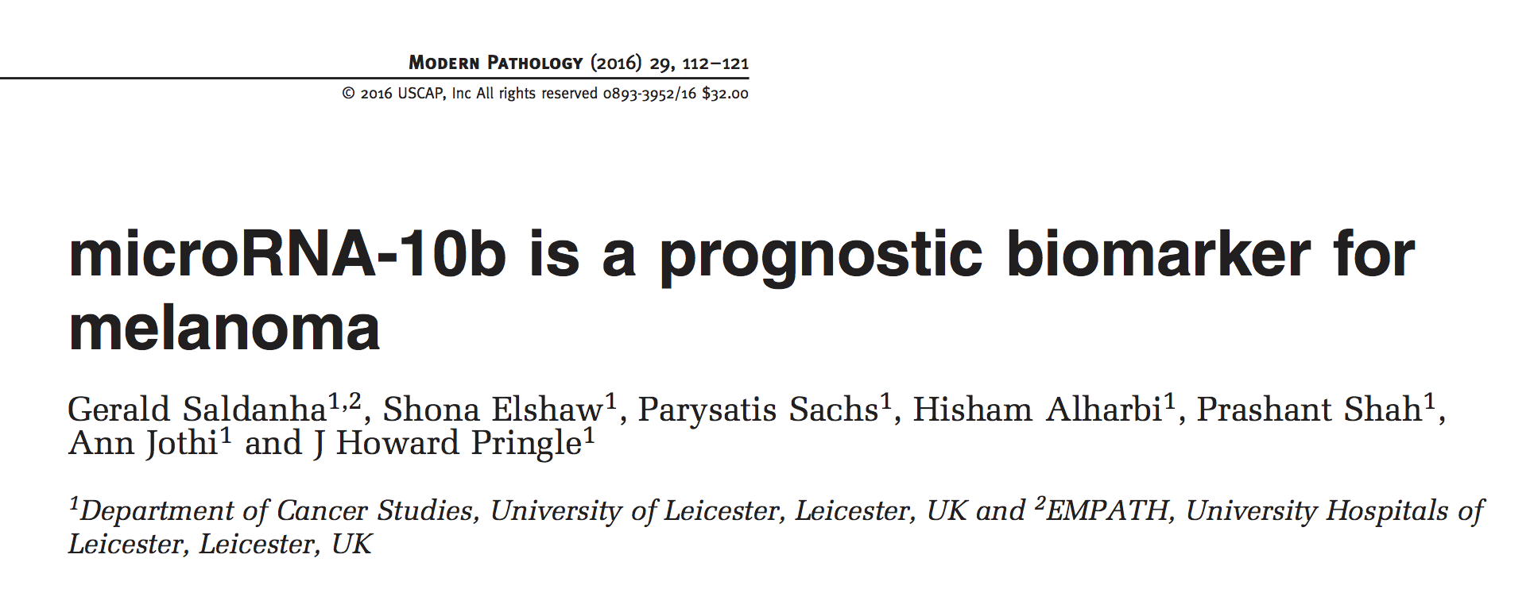
Background
Biochemistry, Faculty of Science KAAU, Jeddah,KSA
MSc Anatomy and histological Technique KAAU, Jeddah, KSA
MSc in Molecular Pathology and Toxicology, Leicester university, UK

Slide 16
Skills and Expertise
Molecular Techniques : Genomic extraction, purification, PCR-qPCR, multiplex, Cloning, In-situ hybridization, Immunohistochemistry and DNA sequencing.
Biochemistry, Immunology, Blood Bank and Haematology
Cell Culture, Parasites Culture, Transfections and gene silencing, antibodies Productions and pathogens’ Proteins production.
Bioinformatic: Primers Design, Sequence Analysis software
Access to patients samples.

Slide 17
Difficulties of Research in KSA
Lack of Expertise in research to conduct strategies and policies for Surveillances and eliminations of infectious diseases.
Parasites studies are neglected and undesirable field.
Lack of Collaborations between Universities and health Authorities.
No Industrial Companies.
Collaboration with Researcher known in their field.
The collaboration for Training and mentoring.

Slide 18



